Slide 1
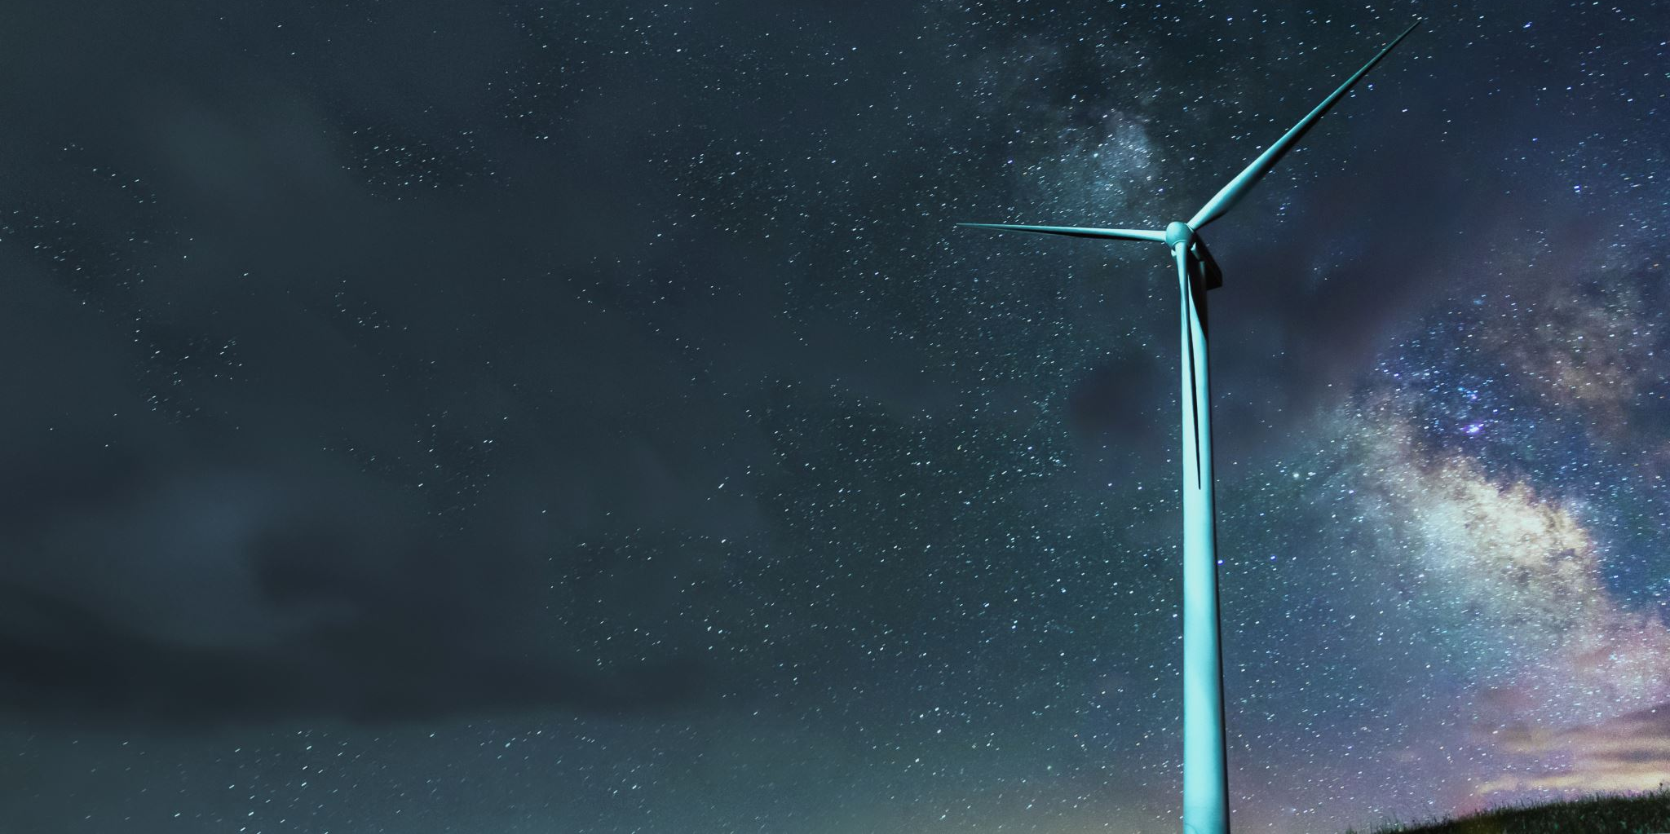

Image caption generator application
Submitted by: C-wizers group

Slide 2
About the application
Being able to automatically describe the content of an image using properly formed English sentences is a challenging task, but it could have a great impact by helping visually impaired people better understand their surroundings.
These images can then be used to generate captions that can be read out loud to the visually impaired so that they can get a better sense of what is happening around them.
We are creating a web application where the user selects the image, and the image is fed into the model that is trained and generated caption will be displayed on the webpage.

Slide 3
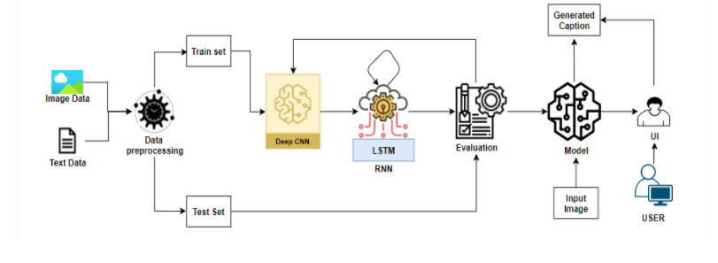
Architecture

Slide 4
project objectives
Know fundamental concepts and techniques of Convolutional Neural Network.
Know fundamental concepts and techniques of Recurrent Neural Network.
Gain a broad understanding of textual data.
Gain a broad understanding of image data.
Know how to pre-process/clean the data using different data preprocessing techniques.
Know how to build a web application using the Flask framework.

Slide 5



Project flow
The user interacts with the UI (User Interface) to upload the image as input
The uploaded image is analyzed by the model which is integrated
Once the model analyses the uploaded image, the generated caption is showcased on the UI

Slide 6
pre-requisites
Following applications, you need to install before hand
1
Anaconda Navigator
2
Tensorflow
3
Keras
4
Flask
5

Slide 7

Thank you

